Slide 1
DEEP DROWSINESS DETECTION

Slide 2
INTRODUCTION
Drowsiness detection is a critical component in enhancing road safety and preventing accidents caused by driver fatigue. This project aims to develop a deep learning model for real-time drowsiness detection using YOLOv5 and PyTorch. The proposed system will leverage state-of-the-art object detection techniques to identify signs of drowsiness in drivers and provide timely alerts. This document outlines the theoretical foundation, methodology, and implementation plan for the project.

Slide 3
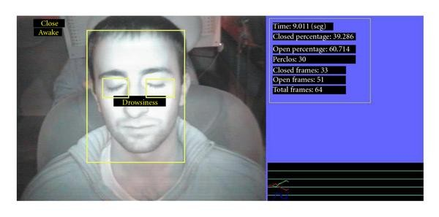
PROBLEM
Drowsiness while driving is a significant cause of road accidents globally. Detecting driver fatigue early can prevent such accidents and save lives. Traditional methods of drowsiness detection often rely on physiological signals or vehicle behavior analysis. However, these methods can be intrusive or limited in accuracy. Deep learning-based computer vision techniques offer a non-intrusive and highly accurate alternative for real-time drowsiness detection.

Slide 4
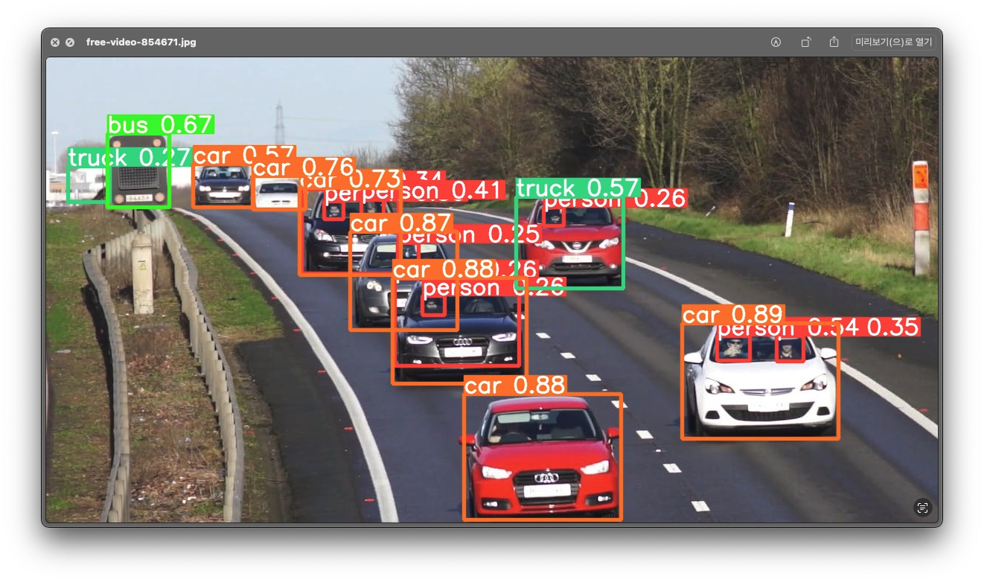
YOLOV5
YOLOv5 is a recent release of the YOLO family of models. YOLO was initially introduced as the first object detection model that combined bounding box prediction and object classification into a single end to end differentiable network.

Slide 5
ULTRALYTICS
Ultralytics HUB is an intuitive AI platform for creating, training, and deploying machine learning models with a no-code interface and deep learning framework support. It simplifies the process and empowers users with an end-to-end solution for deployment to cloud, edge, or browser.

Slide 6

PYTORCH
PyTorch is a fully featured framework for building deep learning models, which is a type of machine learning that's commonly used in applications like image recognition and language processing. Written in Python, it's relatively easy for most machine learning developers to learn and use.
This Photo by Unknown Author is licensed under CC BY-NC

Slide 7

CODE

Slide 8
SETUP
!pip install torch==2.0.1+cu118 torchvision==0.15.2+cu118 torchaudio==2.0.1+cu118 -f https://download.pytorch.org/whl/cu118/torch_stable.html (THIS IS FOR PYTORCH SETUP).
!git clone https://github.com/ultralytics/yolov5.git ,%cd yolov5 (The line clones the YOLOv5 repository from GitHub and then changes the current working directory to the newly cloned yolov5 directory.)
!pip3 install labelImg (to annotate labels)
!pip install -r requirements.txt(intsalls all the necessary modules required)
!pip install opencv-python

Slide 9
import uuid (to create a unique identifier, going to be used to name images)
import os
import time (to take break between taking images)
import pandas as pd
import torch
from matplotlib import pyplot as plt
import numpy as np
import cv2

Slide 10
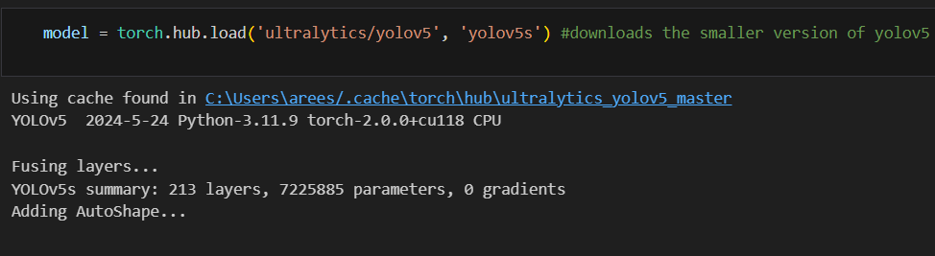
LOADING MODEL
The code loads the smaller version of the YOLOv5 model (`yolov5s`) from the Ultralytics repository using PyTorch Hub. It uses a cached version if available, initializes the model, and prints a summary of its architecture, including layer count and parameters. Additionally, AutoShape functionality is added to the model.

Slide 11
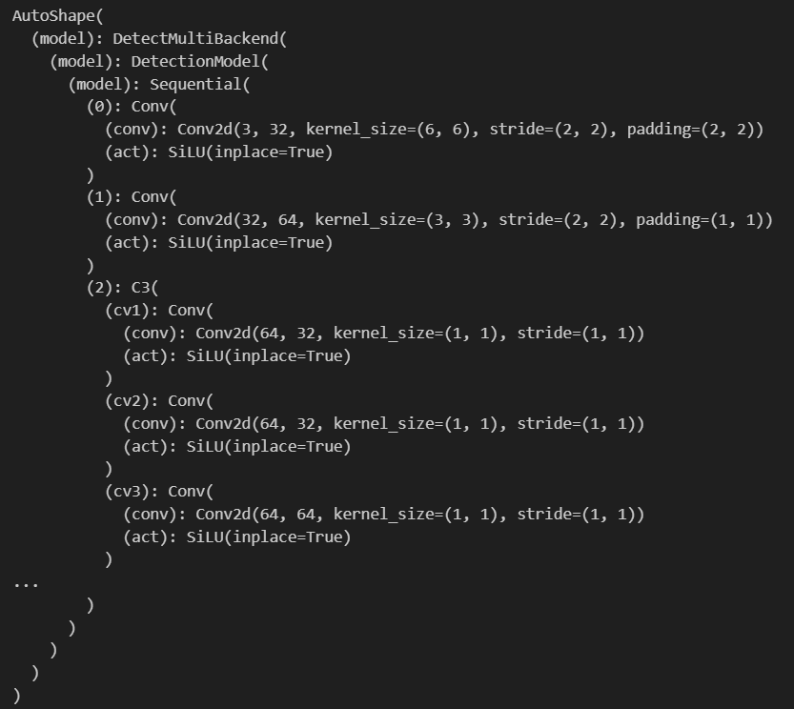
MODEL

Slide 12
LET’S TEST THE MODEL

Slide 13
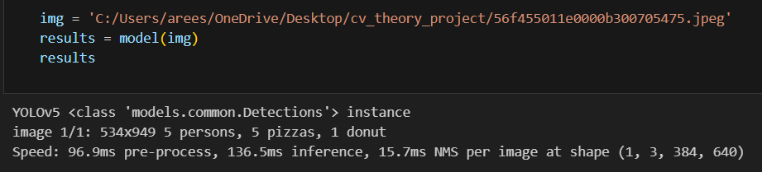
The code loads an image from the specified path and runs it through the YOLOv5 model to get detection results. The output indicates that the model detected 5 persons, 5 pizzas, and 1 donut in the image, along with processing times for each step. The results include pre-process, inference, and non-max suppression times per image.

Slide 14

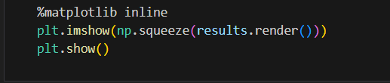
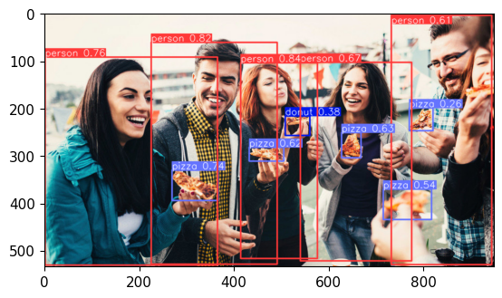
PLOTTING PREDICTION

Slide 15
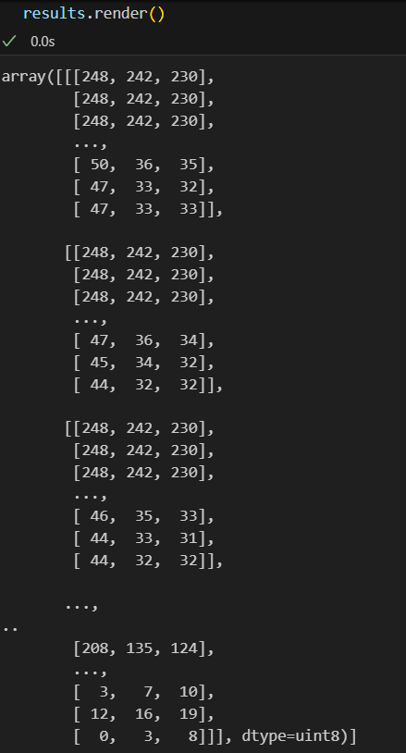
RENDERING RESULT
Rendering the results of the image helps visually verify the model's predictions, ensuring accuracy and correctness, and allows for intuitive identification of errors or areas needing improvement. It aids in evaluating the model's performance in a human-understandable way.

Slide 16
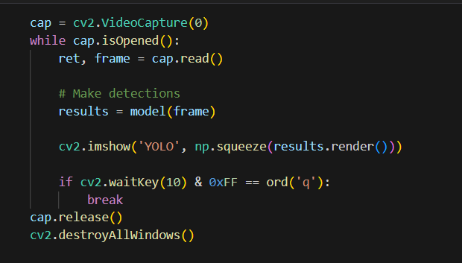
REAL TIME DETECTION USING YOLOV5
Running the piece of code on the right we can open the webcam of our device and make real time object detection using our model

Slide 17
Creating paths to add out images
In the above code we are:
Creating path to add our images by joining our data directory with image directory.
We are then creating 2 classes we want our image to be classified as.
Number_images variable stores that each class will contain 20 each.

Slide 18
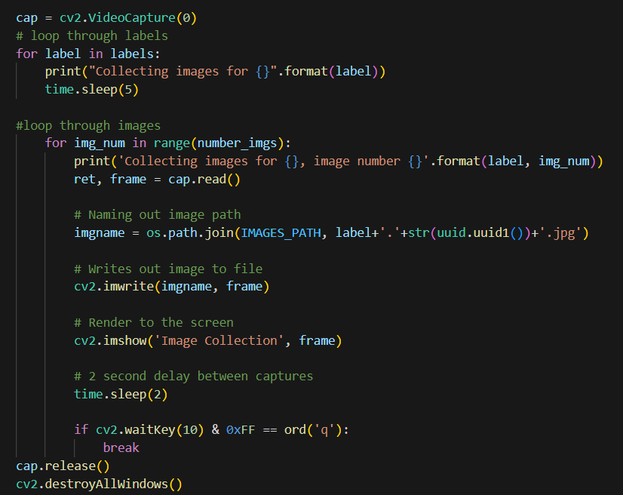
CAPTURING FRAMES IN REAL TIME
This code captures images from a webcam for each label in a list, saving them with unique names. It displays each image on the screen and waits for 2 seconds between captures, allowing for a 5-second delay before starting each label. The capture process stops if 'q' is pressed, and resources are released after completion.

Slide 19
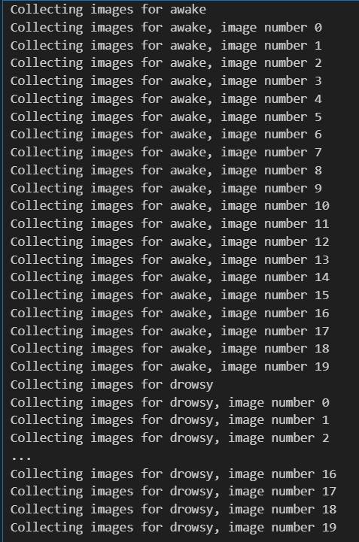
IT WOULD LOOK LIKE THIS WHILE COLLECTING FRAME

Slide 20
LABELIMG
LabelImg is an open-source graphical image annotation tool used to label images for object detection and image classification tasks. It enables users to draw bounding boxes around objects in images and assign labels, creating annotated datasets for training machine learning models. This tool supports multiple annotation formats, facilitating dataset preparation for various deep learning frameworks.

Slide 21
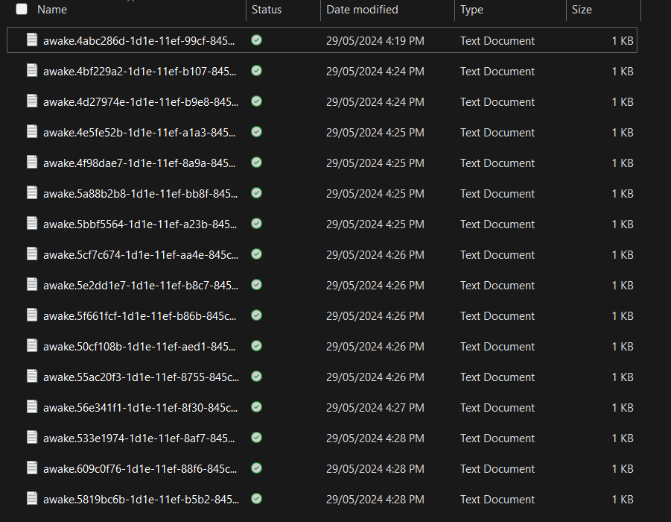
IN THE LABEL DIRECTORY

Slide 22
I have annotated my labels manually image by image by drawing the bounding boxes using labelimg

Slide 23
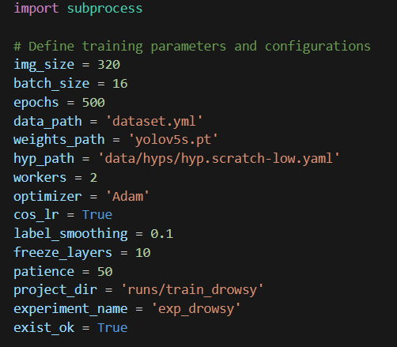
DEFINING TRAINING PARAMETERS

Slide 24
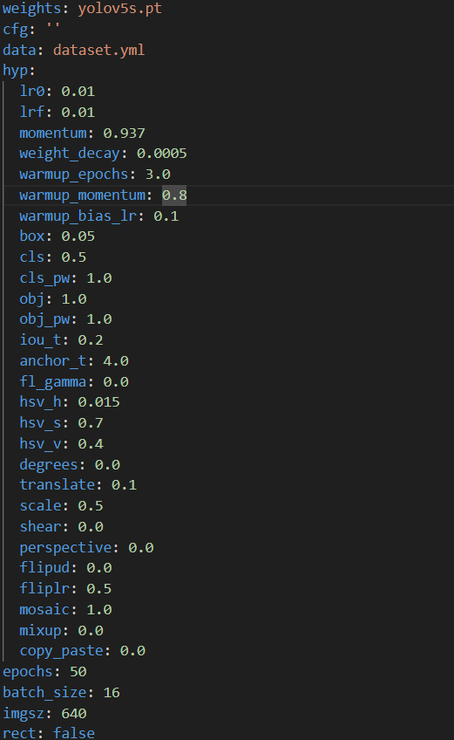
TRAINING WEIGHTS

Slide 25
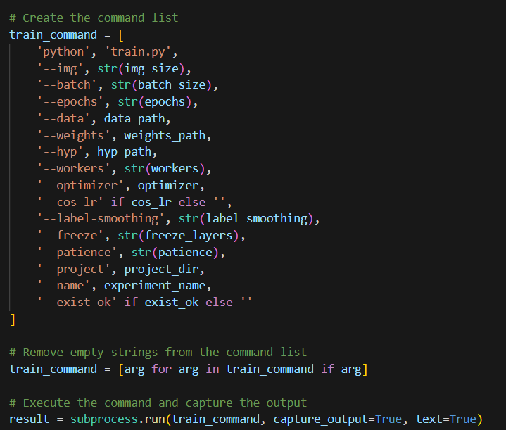
TRAINING MODEL
We are training our model on specific commands

Slide 26
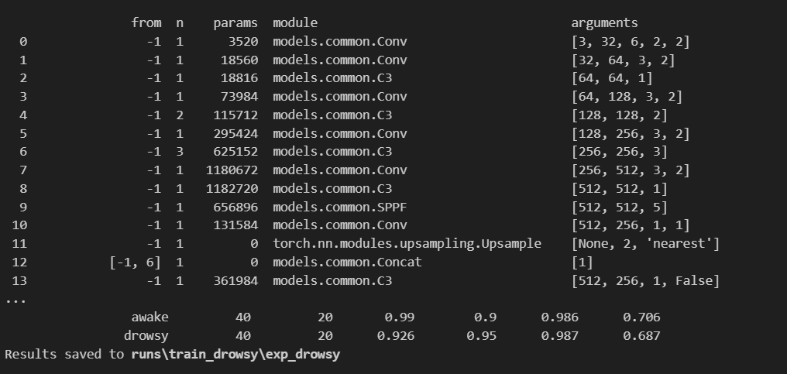
RESULTS
awake
40: Number of ground truth instances for the class.
20: Number of detected instances for the class.
0.99: Precision for the class.
0.9: Recall for the class.
0.986: Mean Average Precision (mAP) for the class.
0.706: F1-score for the class (a balance between precision and recall).
drowsy
40: Number of ground truth instances for the class.
20: Number of detected instances for the class.
0.926: Precision for the class.
0.95: Recall for the class.
0.987: Mean Average Precision (mAP) for the class.
0.687: F1-score for the class (a balance between precision and recall).

Slide 27
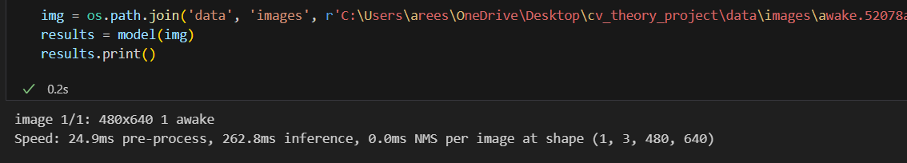
PREDICTION ON IMAGE
YAY! WE HAVE ACHIVED THE ACCURATE PREDICTION

Slide 28
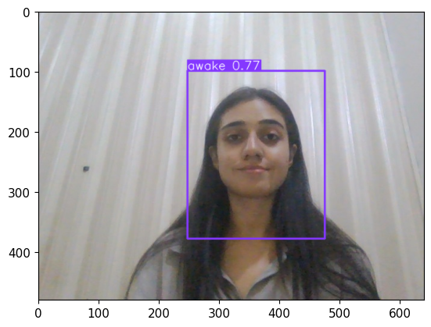
IGNORE ME

Slide 29
LET’S FINE TUNE

Slide 30
FINE TUNING
Fine-tuning is a training technique in machine learning where a pre-trained model is further trained on a new dataset, typically with a smaller learning rate. This process allows the model to adapt its parameters to the new data while leveraging the knowledge gained from the original task, thereby improving performance for the specific task at hand.

Slide 31
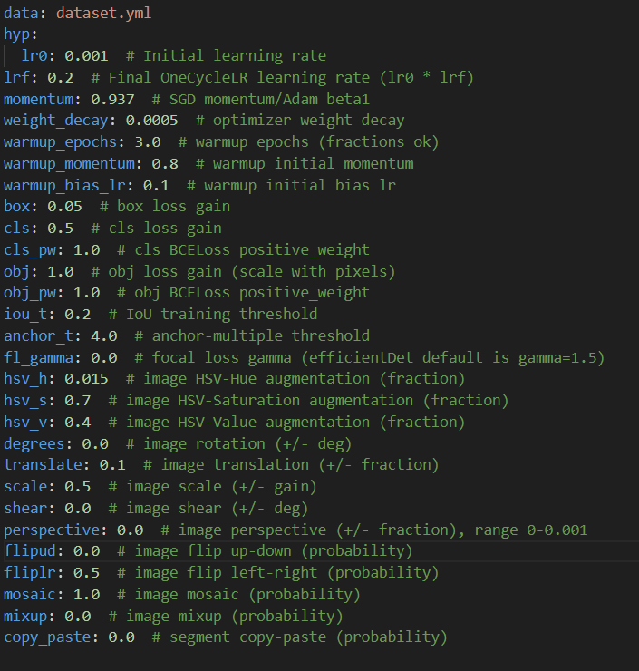
TRAINING WEIGHTS
FOR FINE TUNING

Slide 32
TRANING THE MODEL
This command initiates the training of a YOLOv5 model with the following parameters:
--img 320: Sets the input image size to 320x320 pixels.
--batch 16: Uses a batch size of 16 for training.
--epochs 500: Trains the model for 500 epochs.
--data dataset.yml: Specifies the dataset configuration file dataset.yml.
--weights yolov5s.pt: Initializes the model with pre-trained weights from yolov5s.pt.
--workers 2: Utilizes 2 CPU workers for data loading.

Slide 33
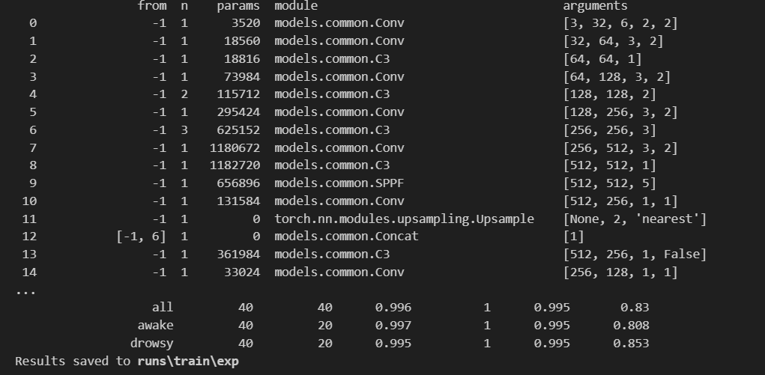

Slide 34
SHOWING: Overall Performance: Precision: 0.962 Recall: 0.911 mAP: 0.975 Class-Specific Performance: Awake: Precision: 0.924 Recall: 1.0 mAP: 0.99 Drowsy: Precision: 1.0 Recall: 0.822 mAP: 0.96

Slide 35
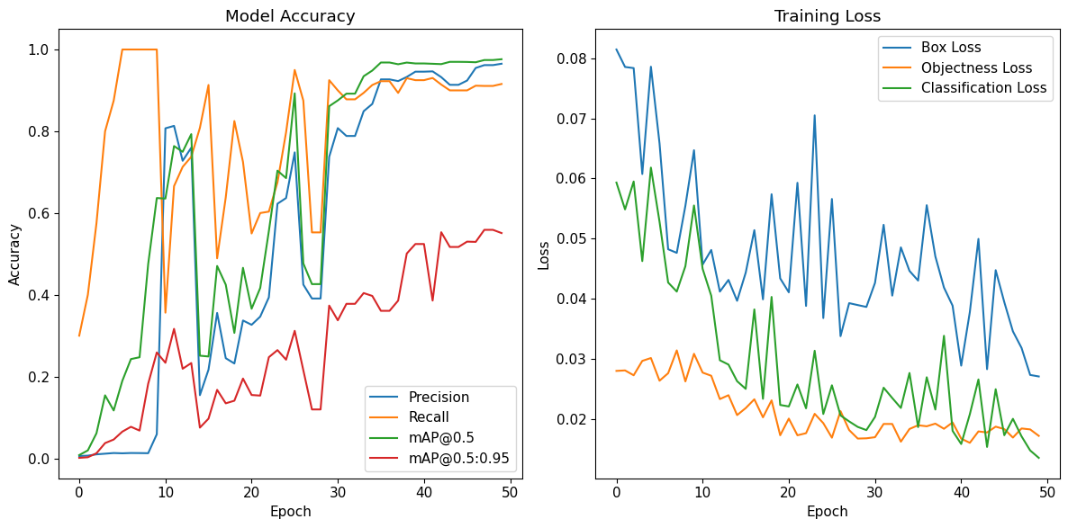
MODEL ACCURACY

Slide 36
THE END

Slide 37
Thank you
AREESHA JAMIL
F2021376108
F2021376108@umt.edu.pk

